Slide 1
Introduction to Trees (Cont.)
Course Code:
Course Title:
Dept. of Computer Science
Faculty of Science and Technology
Lecturer No: | 21 | Week No: | 12 | Semester:
Lecturer: | Name & email

Slide 2
Lecture Outline
9.1 Introduction to Trees

Slide 3
Objectives and Outcomes
Objectives: To introduce Tree and Forest and different jargons associated with that. To educate types of Trees and Forest to the student. Explain theorem related to tree. To demonstrate student how to solve mathematical problems by using different theorem and formula.
Outcomes: After this class the student will be able to define different kind Tree and Forest. They will be capable of demonstrating theorems. Finally, by using Tree linked theorem they will be able to sort out math problems.

Slide 4
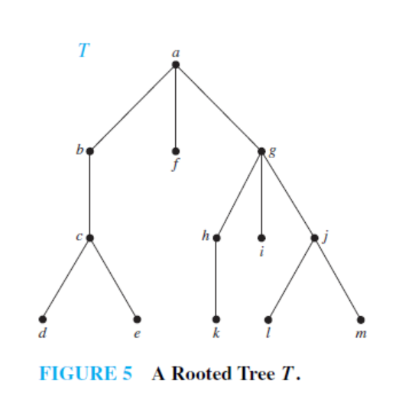
Example 2
In the rooted tree T (with root a) shown in Figure 5, find the parent of c, the children of g, the siblings of h, all internal vertices, and all leaves. What is the subtree rooted at g?

Slide 5
Solution of EXAMPLE 2
The parent of c is b.
The children of g are h, i, and j .
The siblings of h are i and j .
The internal vertices are a, b, c, g, h, and j .
The leaves are d, e, f , i, k, l, and m.
The subtree rooted at g is shown in Figure 6(next slide)

Slide 6
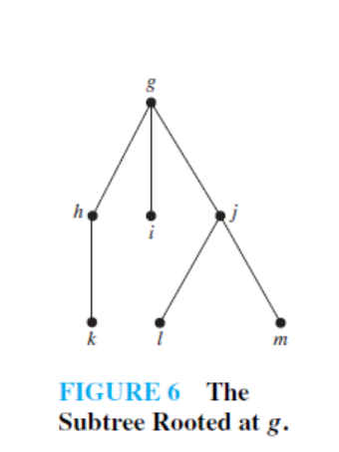
Solution of EXAMPLE 2
The subtree rooted at g is shown in Figure 6

Slide 7
m-ary tree, full m-ary tree, binary tree
A rooted tree is called an m-ary tree if every internal vertex has no more than m children.
The tree is called a full m-ary tree if every internal
vertex has exactly m children.
An m-ary tree with m = 2 is called a binary tree.

Slide 8
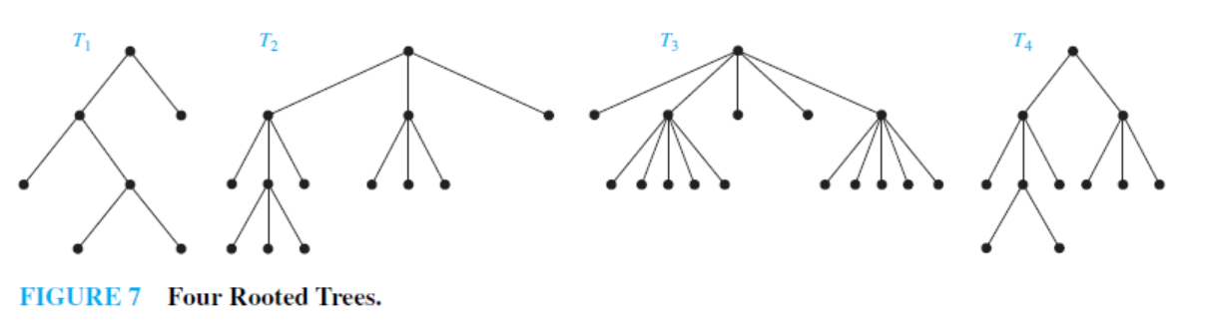
Example 3
Are the rooted trees in Figure 7 full m-ary trees for some positive integer m?

Slide 9
Solution of Example 3
T1 is a full binary tree because each of its internal vertices has
two children.
T2 is a full 3-ary tree because each of its internal vertices has three children.
In T3 each internal vertex has five children, so T3 is a full 5-ary tree.
T4 is not a full m-ary tree for any m because some of its internal vertices have two children and others have three children.
Example 4 : Practice @ Home

Slide 10
Properties of Trees
Theorem: A tree with n vertices has n − 1 edges.
Theorem: A full m-ary tree with i internal vertices contains n = mi + 1 vertices.

Slide 11
Properties of Trees
Theorem: A full m-ary tree with
n vertices has i = (n − 1)/m internal vertices and
l = [(m − 1)n + 1] / m leaves,
i internal vertices has n = mi + 1 vertices and
l = (m − 1)i + 1 leaves,
iii. l leaves has n = (ml − 1)/(m − 1) vertices and
i = (l − 1)/(m − 1) internal vertices

Slide 12
Exercise
17. How many edges does a tree with 10,000 vertices have?
18. How many vertices does a full 5-ary tree with 100 internal
vertices have?
19. How many edges does a full binary tree with 1000 internal
vertices have?
20. How many leaves does a full 3-ary tree with 100 vertices
have?
27. Construct a complete binary tree of height 4 and a complete 3-ary tree of height 3.

Slide 13
Exercise
17. How many edges does a tree with 10,000 vertices
have?
Solution:
Here, n = 10000
e = n –1 = 9999

Slide 14
Exercise
18. How many vertices does a full 5-ary tree with 100
internal vertices have?
Solution:
Here, m = 5, i = 100
Therefore, n = mi + 1 = 5.100 + 1 = 501

Slide 15
Exercise
19. How many edges does a full binary tree with 1000 internal vertices have?
Solution:
Here, m = 2, i = 1000
So, n = mi + 1
= 2.1000 + 1
= 2001
Therefore, e = n – 1
= 2001 –1
= 2000

Slide 16
Exercise
20. How many leaves does a full 3-ary tree with 100 vertices have?
Solution:
Here, m = 3, n = 100
l = [(m –1)n + 1 ]/m
= [(3 –1)100 + 1 ]/ 3
= 201/3
= 67

Slide 17
Level of vertices and height of Trees
When working with trees, we often want to have rooted trees where the subtrees at each vertex contain paths of approximately the same length.
To make this idea precise we need some definitions:
The level of a vertex v in a rooted tree is the length of the unique path from the root to this vertex.
The height of a rooted tree is the maximum of the levels of the vertices.

Slide 18
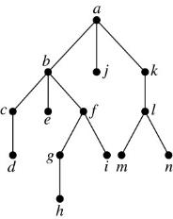
Level of vertices and height of Trees
Example:
(i) Find the level of each vertex in
the tree to the right.
(ii) What is the height of the tree?
Solution:
(i) The root a is at level 0. Vertices b, j, and k are at level 1.
Vertices c, e, f, and l are at level 2. Vertices d, g, i, m, and n are at level 3.
Vertex h is at level 4.
(ii) The height is 4, since 4 is the largest level of the vertices in this tree
(vertex h).

Slide 19
Illustration of Level of vertices
level 0
level 1
level 2
level 3

Slide 20
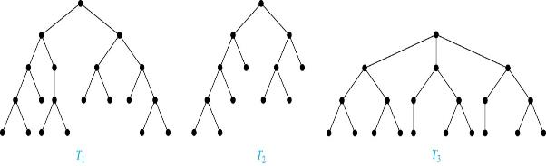
Balanced m-ary Trees
Definition: A rooted m-ary tree of height h is balanced if all leaves are at levels h or h − 1.
Example: Which of the rooted trees shown below is balanced?
Solution: T₁ and T₃ are balanced, but T₂ is not because it has leaves at levels 2, 3, and 4.

Slide 21
The Bound for the Number of Leaves in an m-ary Tree
Theorem 5: There are at most m^{h} leaves in an m-ary tree of height h.

Slide 22
Books
Rosen, K. H., & Krithivasan, K. (2012). Discrete mathematics and its applications: with combinatorics and graph theory. Tata McGraw-Hill Education. (7th Edition)
Liu, C. L. (1986). Elements of discrete mathematics. Tata McGraw-Hill Education.

Slide 23
References
Discrete Mathematics, Richard Johnsonbaugh, Pearson education, Inc.
Discrete Mathematical Structures, Bernard Kolman, Robert C. Busby, Sharon Ross, Prentice-Hall, Inc.
SCHAUM’S outlines Discrete Mathematics(2nd edition), by Seymour Lipschutz, Marc Lipson
University of Wisconsin-Madison
http://pages.cs.wisc.edu/~deppeler/cs367-common/readings/Trees/intro.html
Bradfield School of Computer Science
https://bradfieldcs.com/algos/trees/introduction/

